Slide 1
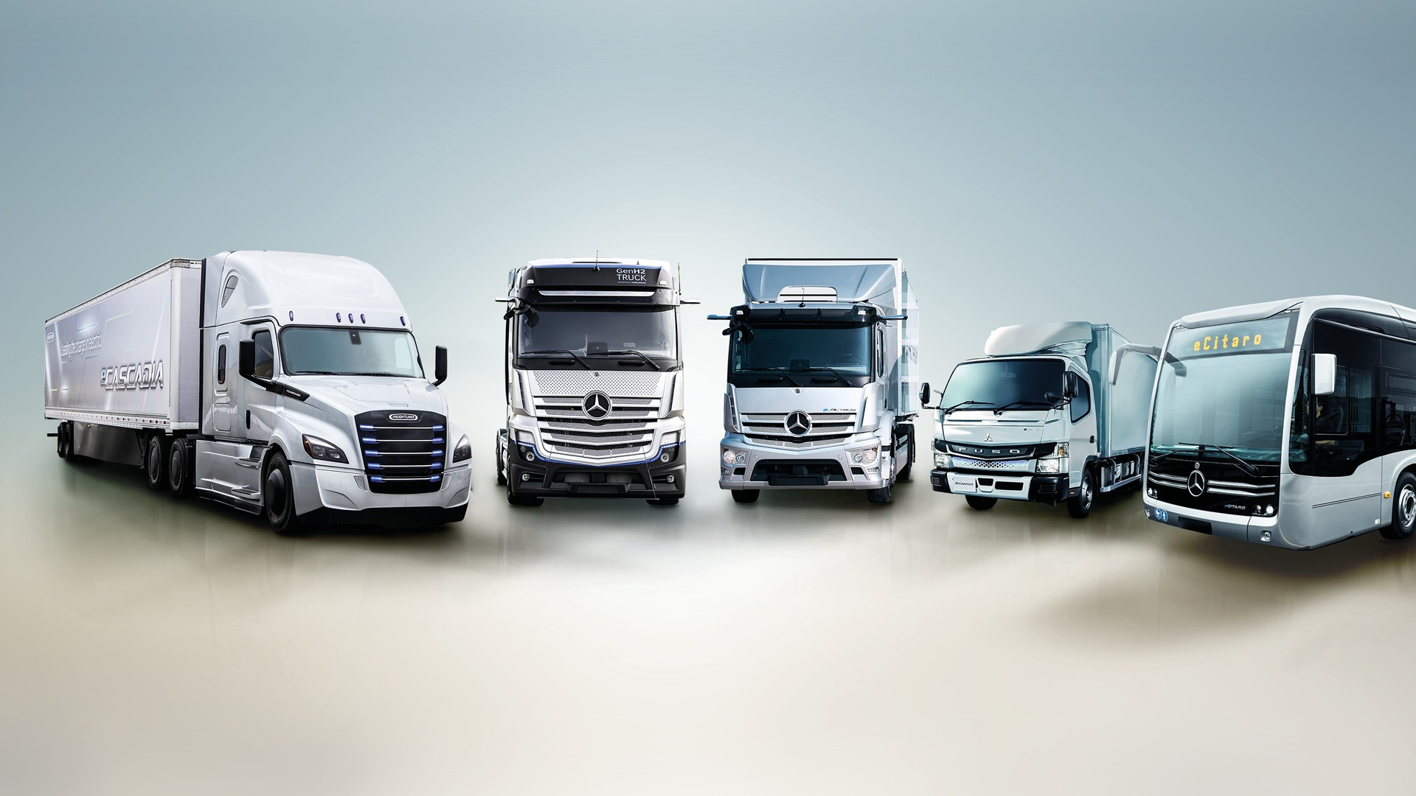
Risk analysis of truck drivers
Sai Pranay Reddy Aare Indrasena Reddy Vukanti
Sai Teja Narahari Poorna Srinivas kanakamedala
VSSMK Sumanth Chilamakuri Vinh Huynh

Slide 2
AGENDA
Business Objective
Workflow
Schema
Business Models
Summary

Slide 3
Business objective
Truck accidents continue to be one of the leading causes of injuries and deaths in the United States.
The project's goal is to identify truck drivers across the state of California, as well as truck models and cities with high risk factors.

Slide 4
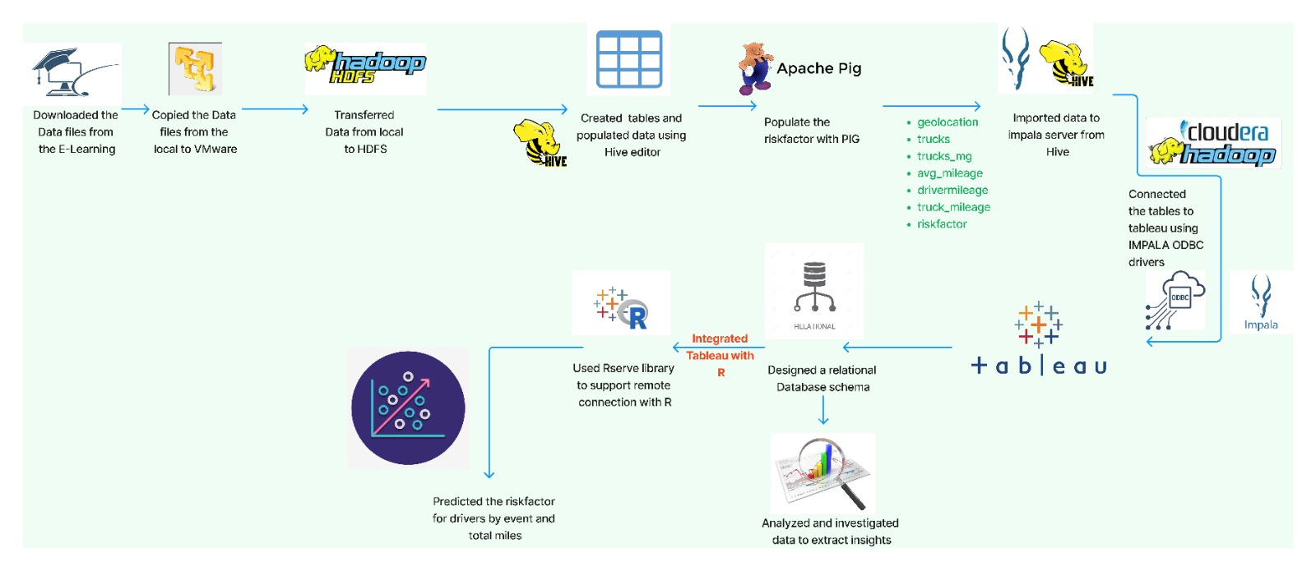
PROJECT WORKFLOW

Slide 5
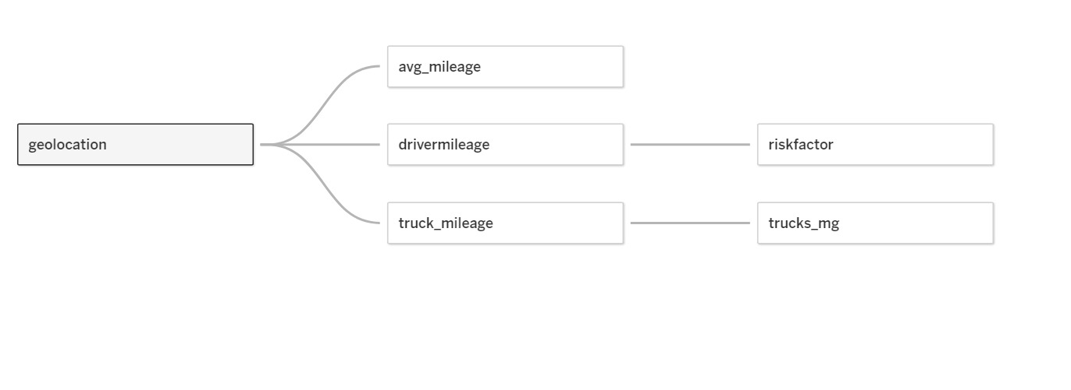
SCHEMA

Slide 6
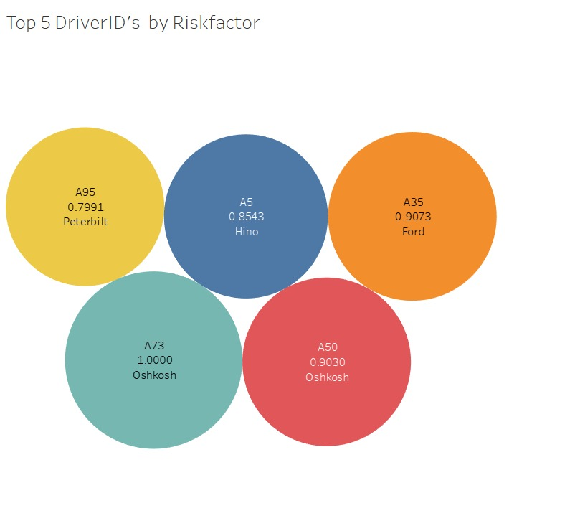
Story 1
A97 has the highest risk factor out of any other drivers and is considered an outlier.
Of the top 5 drivers, A73 has the highest risk factor with a value of 1.
Oshkosh truck model has highest risk factor.

Slide 7
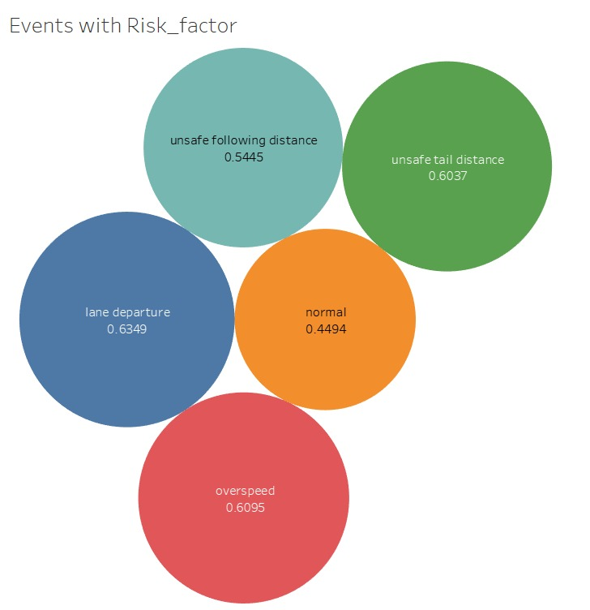
Story 2
Plotted the abnormal events by risk factor
The risk factor is more when the drivers are changing lanes.
The risk factor for driver is less when they are driving normally.

Slide 8
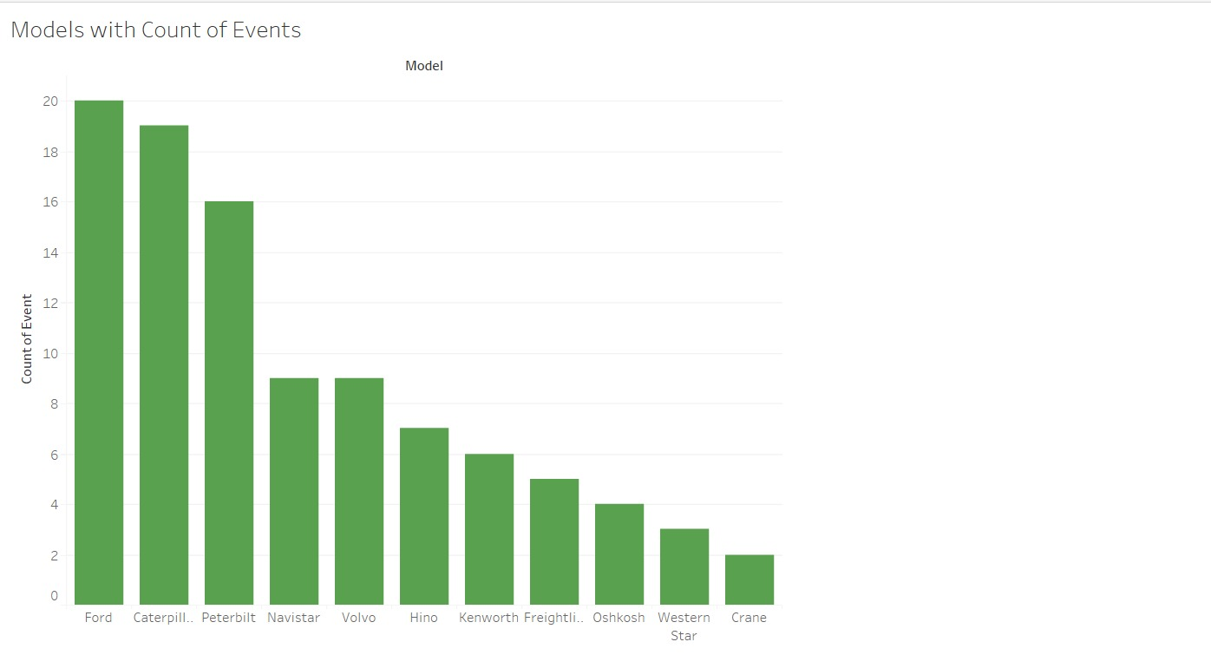
Story 3
The Ford model has highest number of events followed by Caterpillar.
Crane model has least number of events.

Slide 9
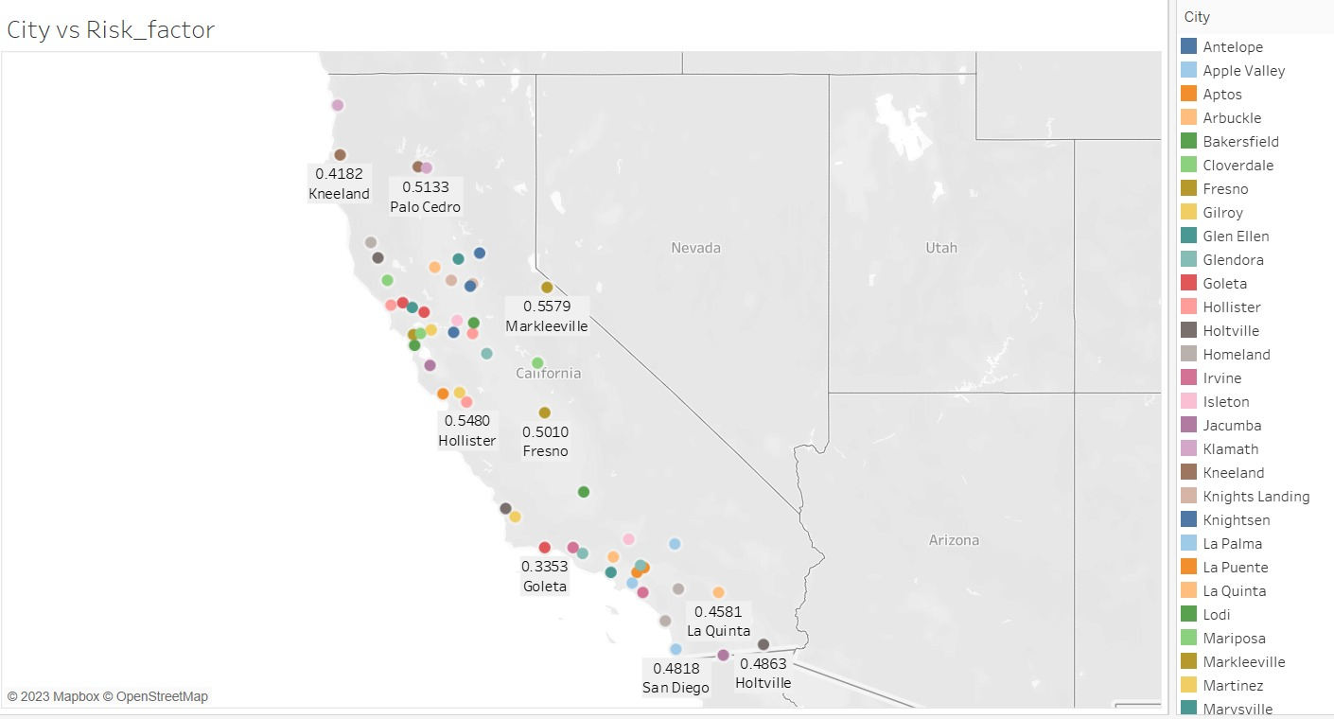
Story 4
Geography is crucial in the analysis of the events that had place.
The cities with risk factors were depicted in the chart.
Major risk cities include Santa Rosa followed by Willits.

Slide 10
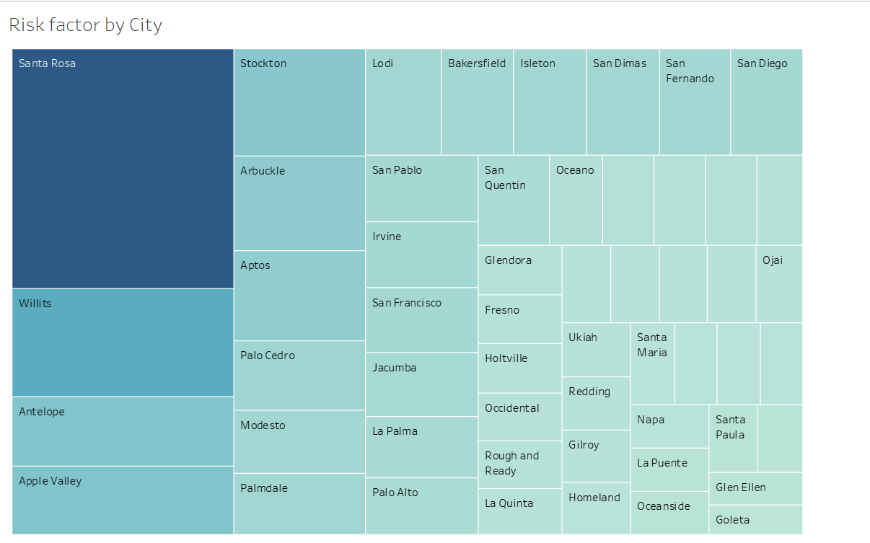

Slide 11
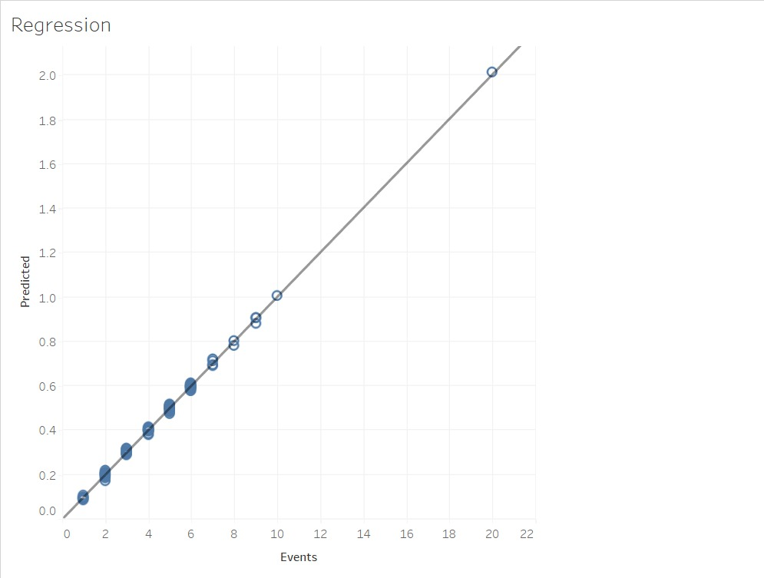
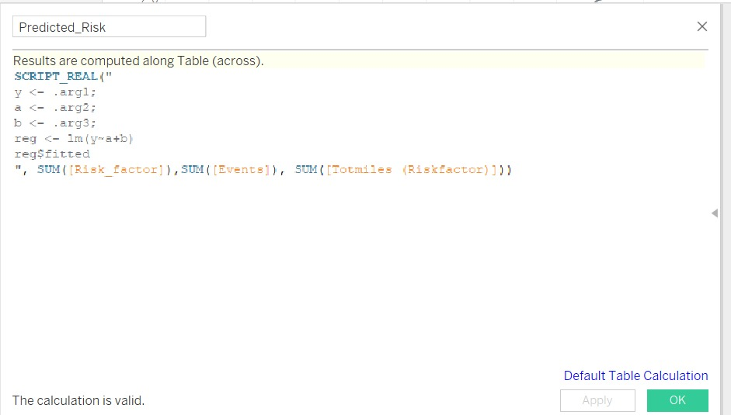
Story 5

Slide 12
Predicted the risk factor taking Events and Total miles as independent variable.
The regression model obtained has R-squared of 0.99.

Slide 13
SUMMARY
Top 5 dangerous drivers include: The most dangerous driver is A97, followed by A73, A35, A50, and A5.
Events: The most unwelcome ones were caused by Ford, Peterbilt, and Caterpillar.
Models of Ford and Peterbilt trucks share the issue of a hazardous following distance.
In addition to them, caterpillar trucks also struggle with lane departure.
Unsafe Cities: Major risk cities include Santa Rosa and Willits
Crane is a trustworthy model.
Oshkosh is an unreliable model.

Slide 14
THANK YOU

